Slide 1
ESP32 Camera
Video
microscope
Incubator
Microscope
Anglerfish
Omniscope
Microfluidics
Microscopy on-the-go
Long-term observations in cell incubator
observe growth of biofilms in situ autonomously
- 24 cameras observing multi wellplate wirelessly
live stream
set additional motors/leds
save/download images
Send to cloud for processing
timelapse
stream stays on
FTP Server for file download
save images on SD card
provide website for settings
live stream
settings
provide webpage
low-power timelase to SD card
get frames
get live stream (low res)
set parameters
stable wifi connection

Slide 2
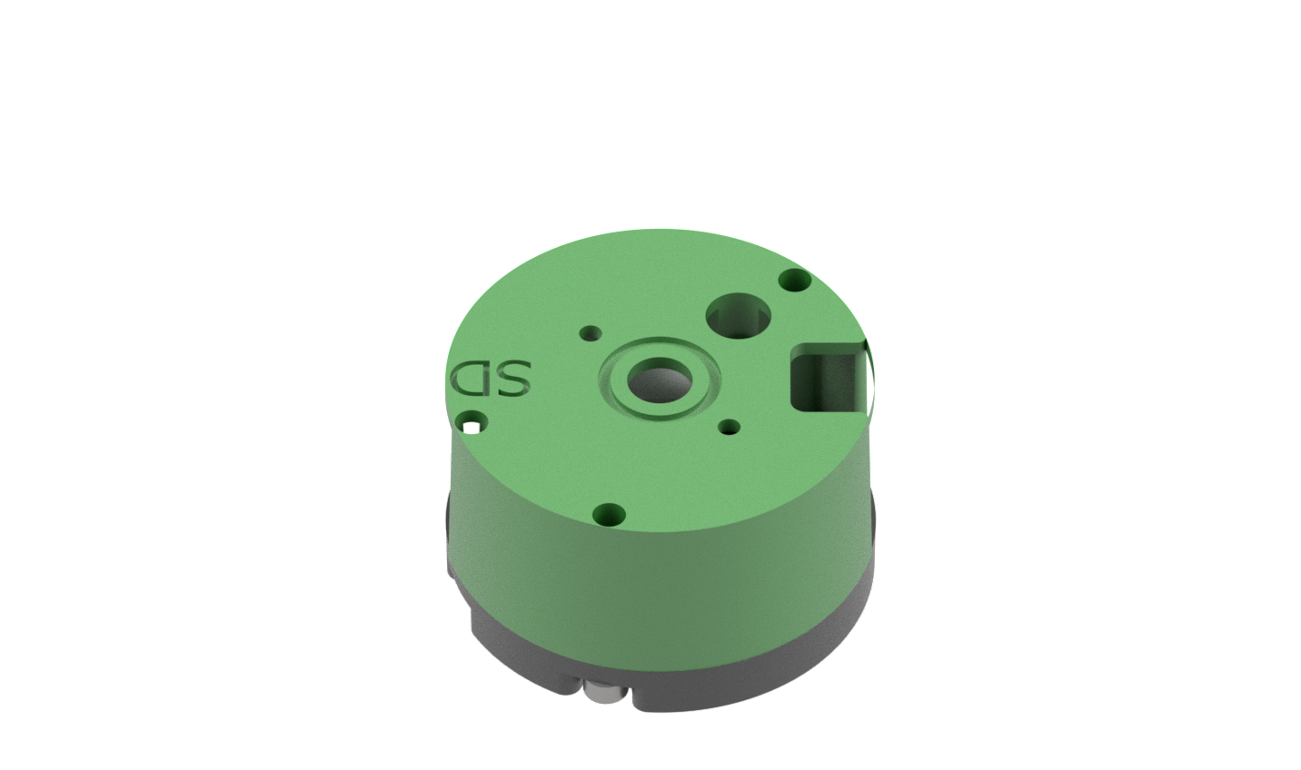
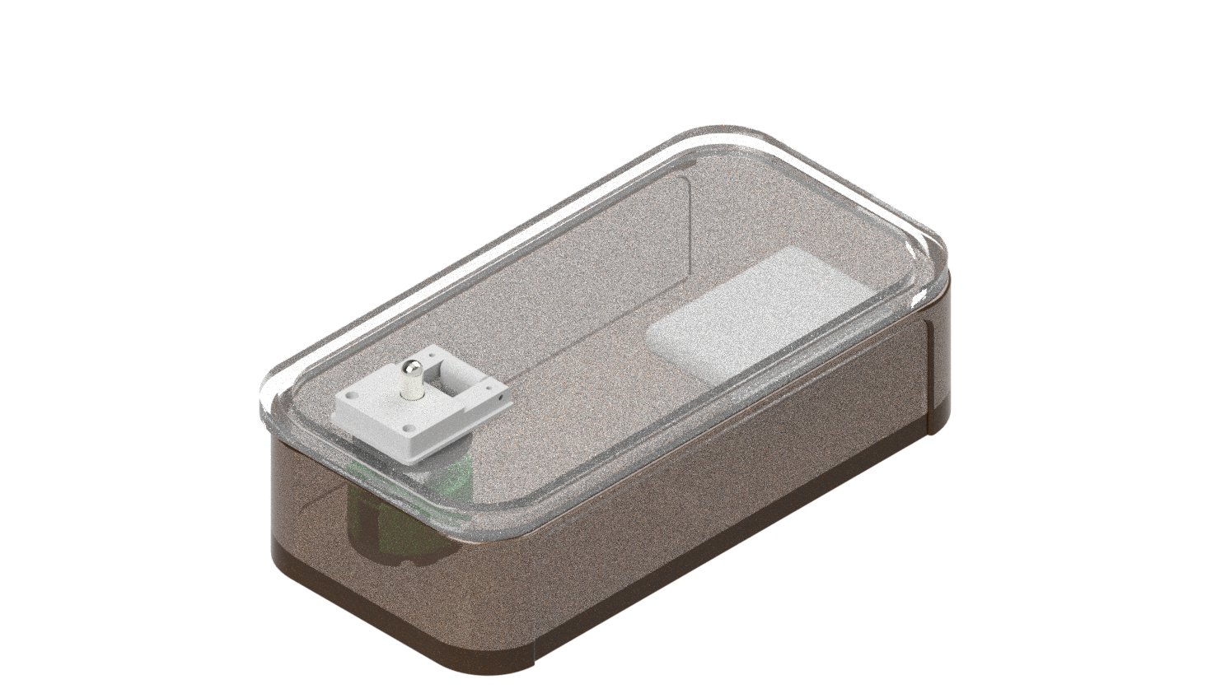
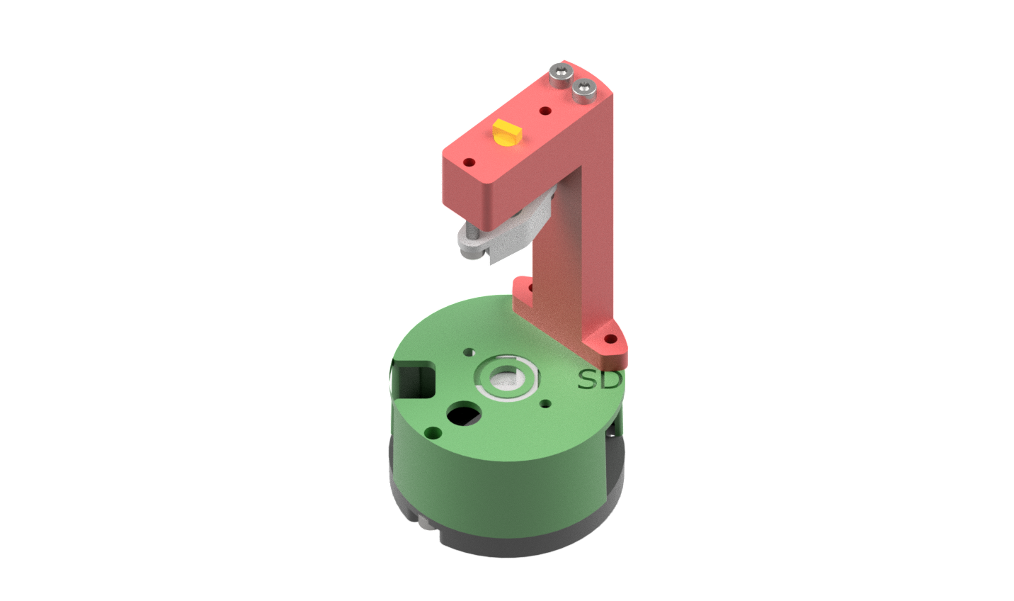
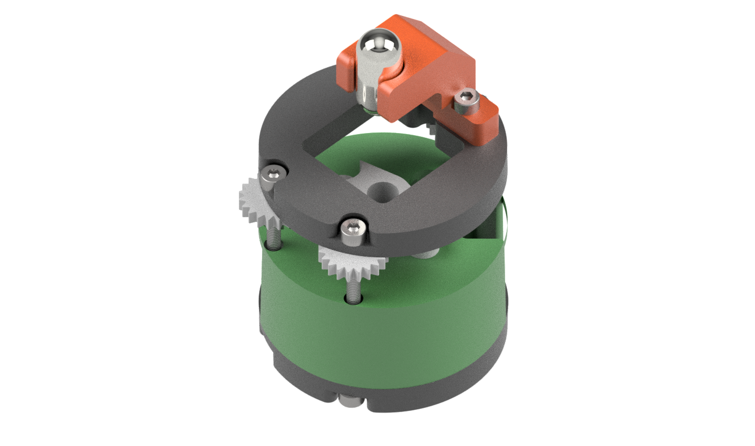
ESPressoscope
Camera base
General purpose firmware
Anglerfish
Watertight assembly
Autofocussing through voice-coil motor
Time-lapse imaging under water
Matchboxscope
LED-based illumination
Brightfield Imaging
Manual focussing stage
Holoscope
LED-based pointsource
Inline holographic microscopy
Lensless imaging

Slide 3


Slide 4
Start
Connect to available Wifi
SSID: Blynk*
Password: 12345678*
Connection successful after 8s?
Open Access Point
SSID: Matchboxscope-ID**
* Blynk/12345678 will be the default network and will be replaced by the one you set in the GUI (optional)
**ID represents a random number between N=0..9; The LED flashes N-times
Connect to this Access Point /w phone/laptop/PC
Find IP address of Matchboxscope (i.e. read Serial output, use „Fing“ App on Android/iPhone or consult your wifi router
Navigate to 192.168.4.1 with the browser and use the UI
Navigate to X.X.X.X (Matchboxscope‘s IP Address) and use the UI
(Optional) Enter new SSID/Password in the dedicated UI-field, accept settings and reboot the device

Slide 5
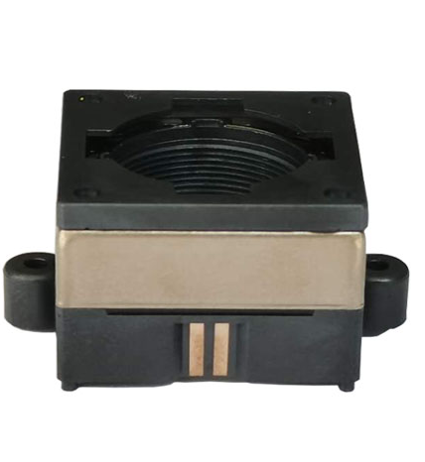
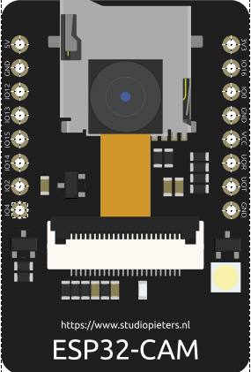
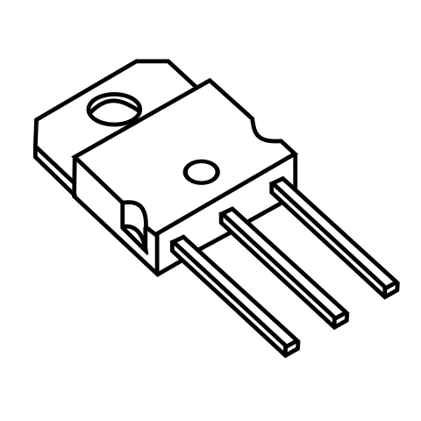
Lens-
focus
ESP32 Camera (AiThinker)
5V
GND
Signal
Base
Collector
Emitter
3
2
1
NPN transistor (e.g. BD809)

Slide 6
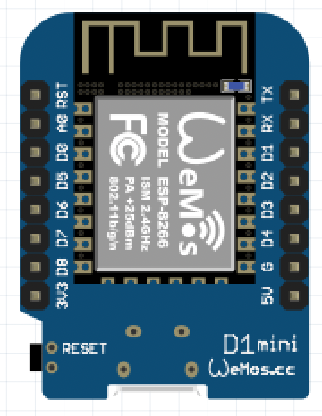
ESP32Mini Wemos D1
ESP32 Camera (AiThinker)
GND
Signal

Slide 7
Webserver
Website (GUI)
Power Management
OTA
Stream (port 81)
Stream (port 81)
Change Camera Parameters
Deep Sleep
REST APIS (80)
Webpage
(80)
Send to ImJoy
Timelapse
Switch
Image Acquisition
File IO
Focus
Camera Frame Acquisition
Upload GDrive
Image Post Processing
(optional) Autofucus
Light
Camera Parameter
Save to SD Card
Focus Stack

Slide 8

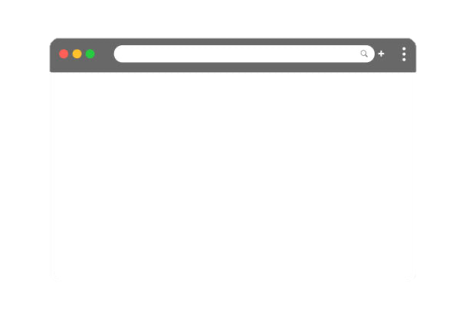
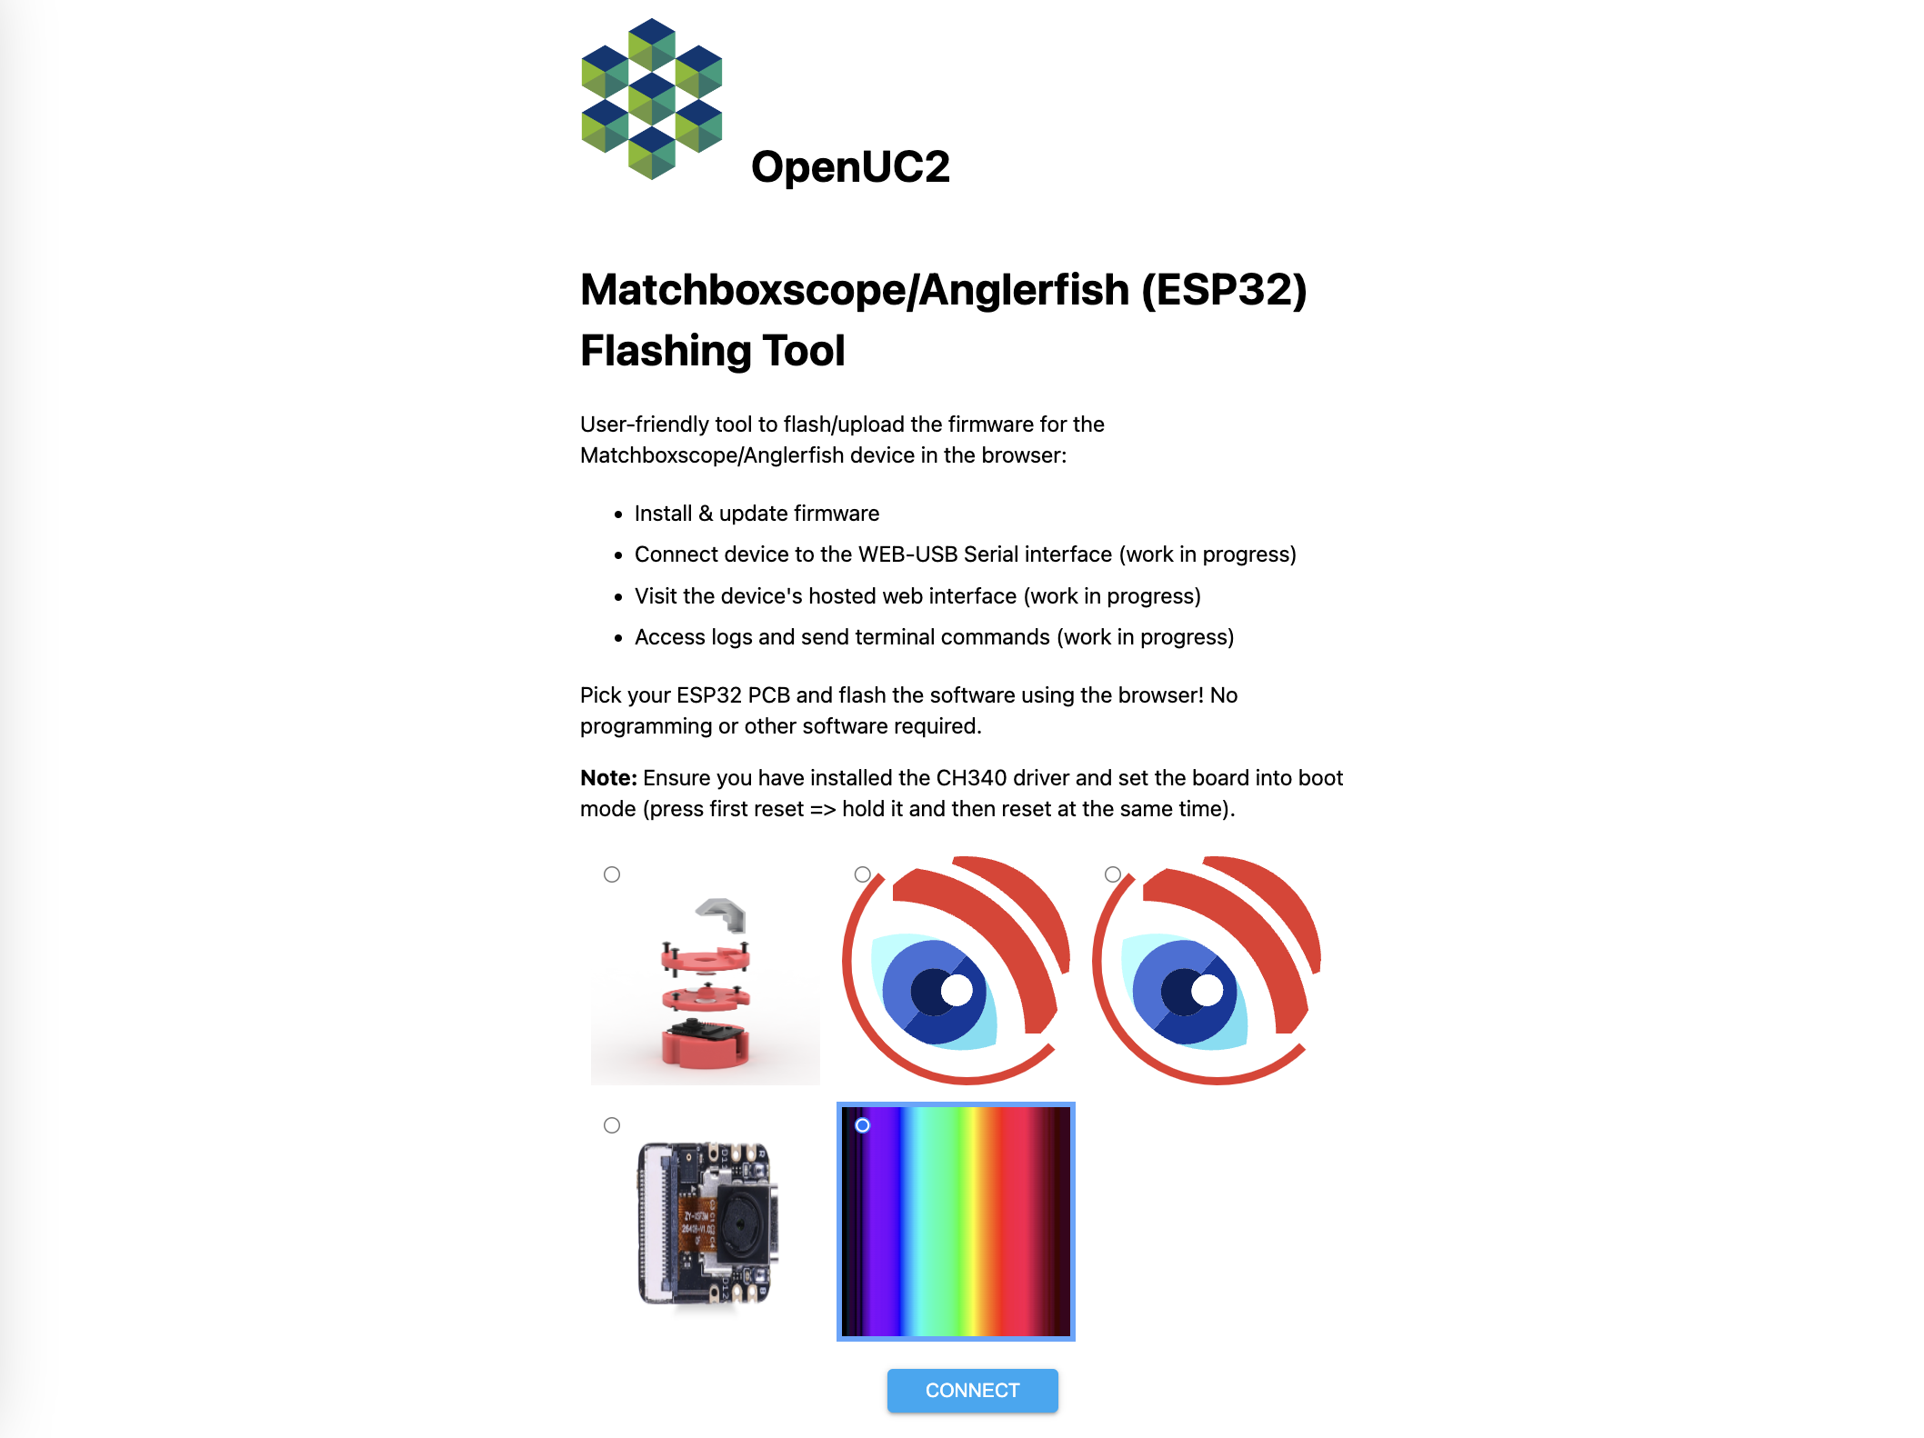
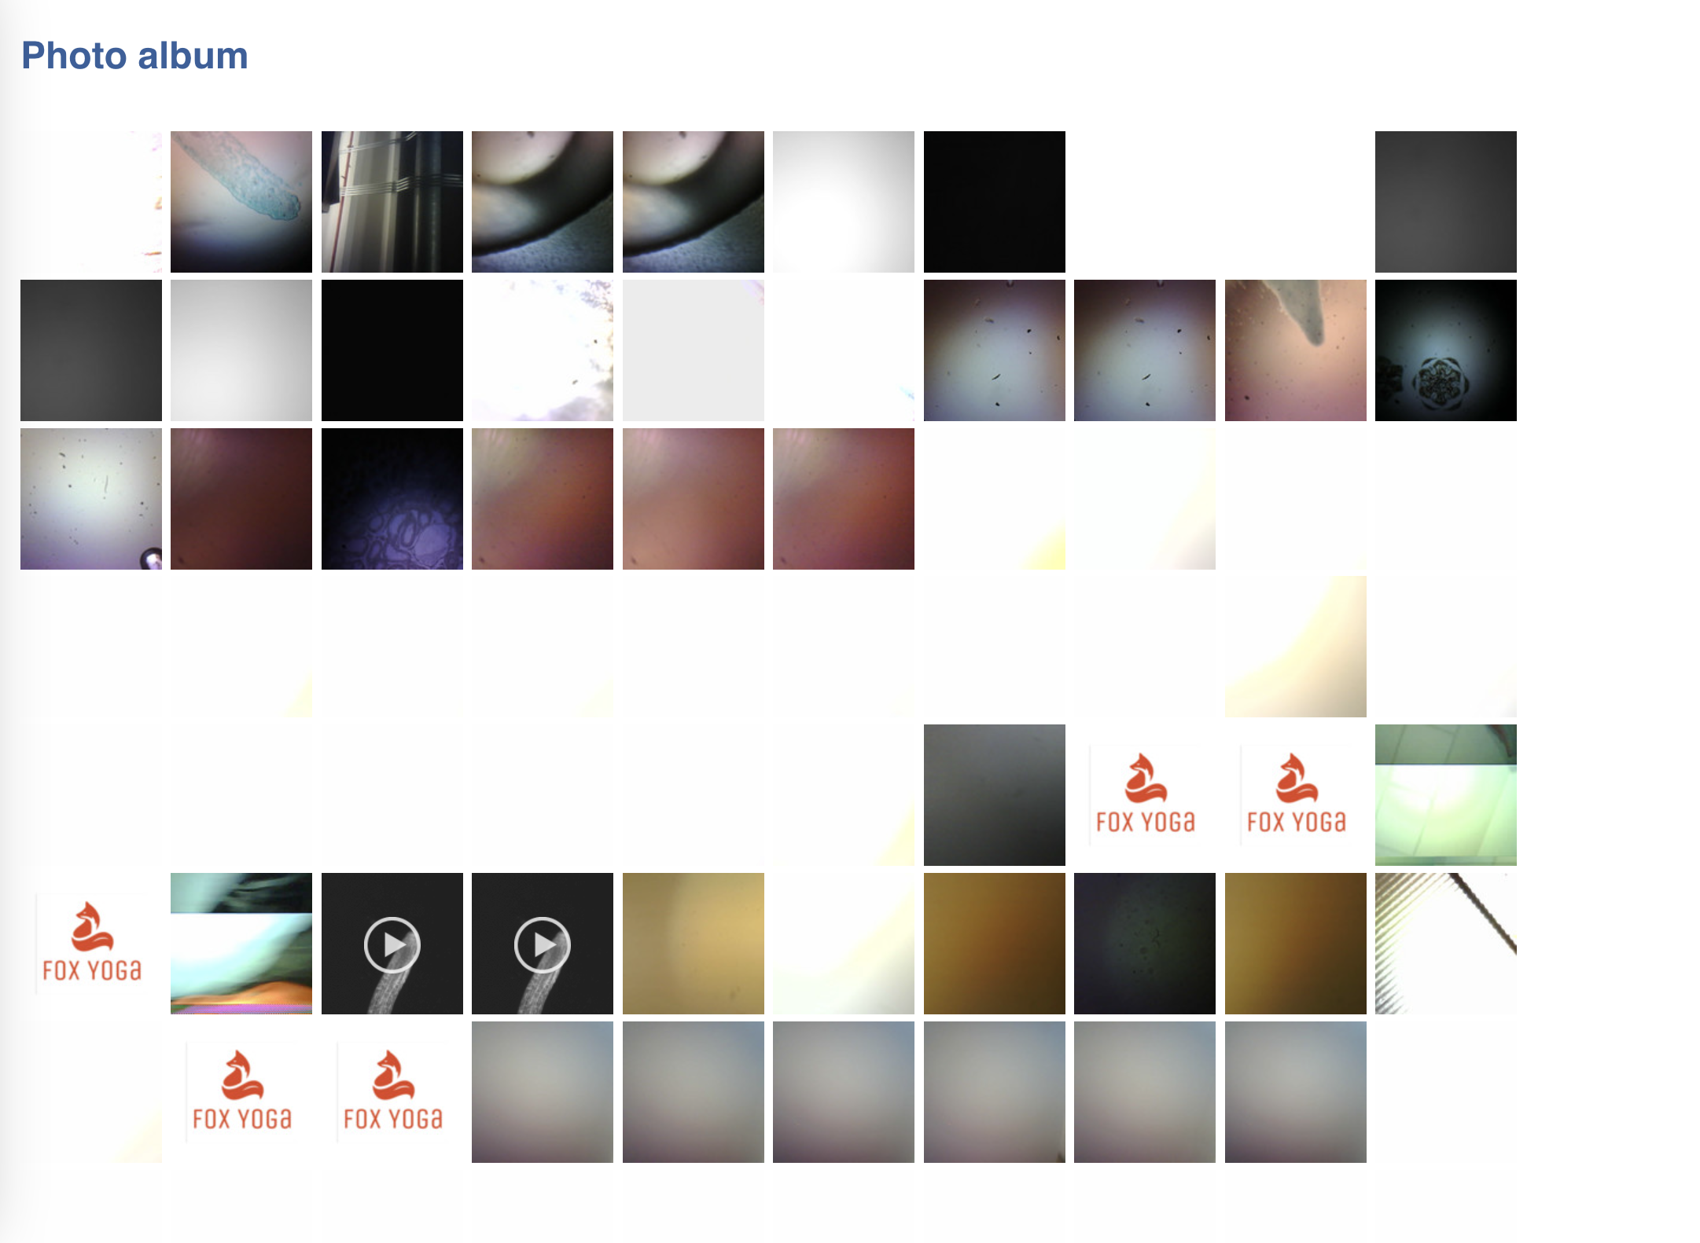
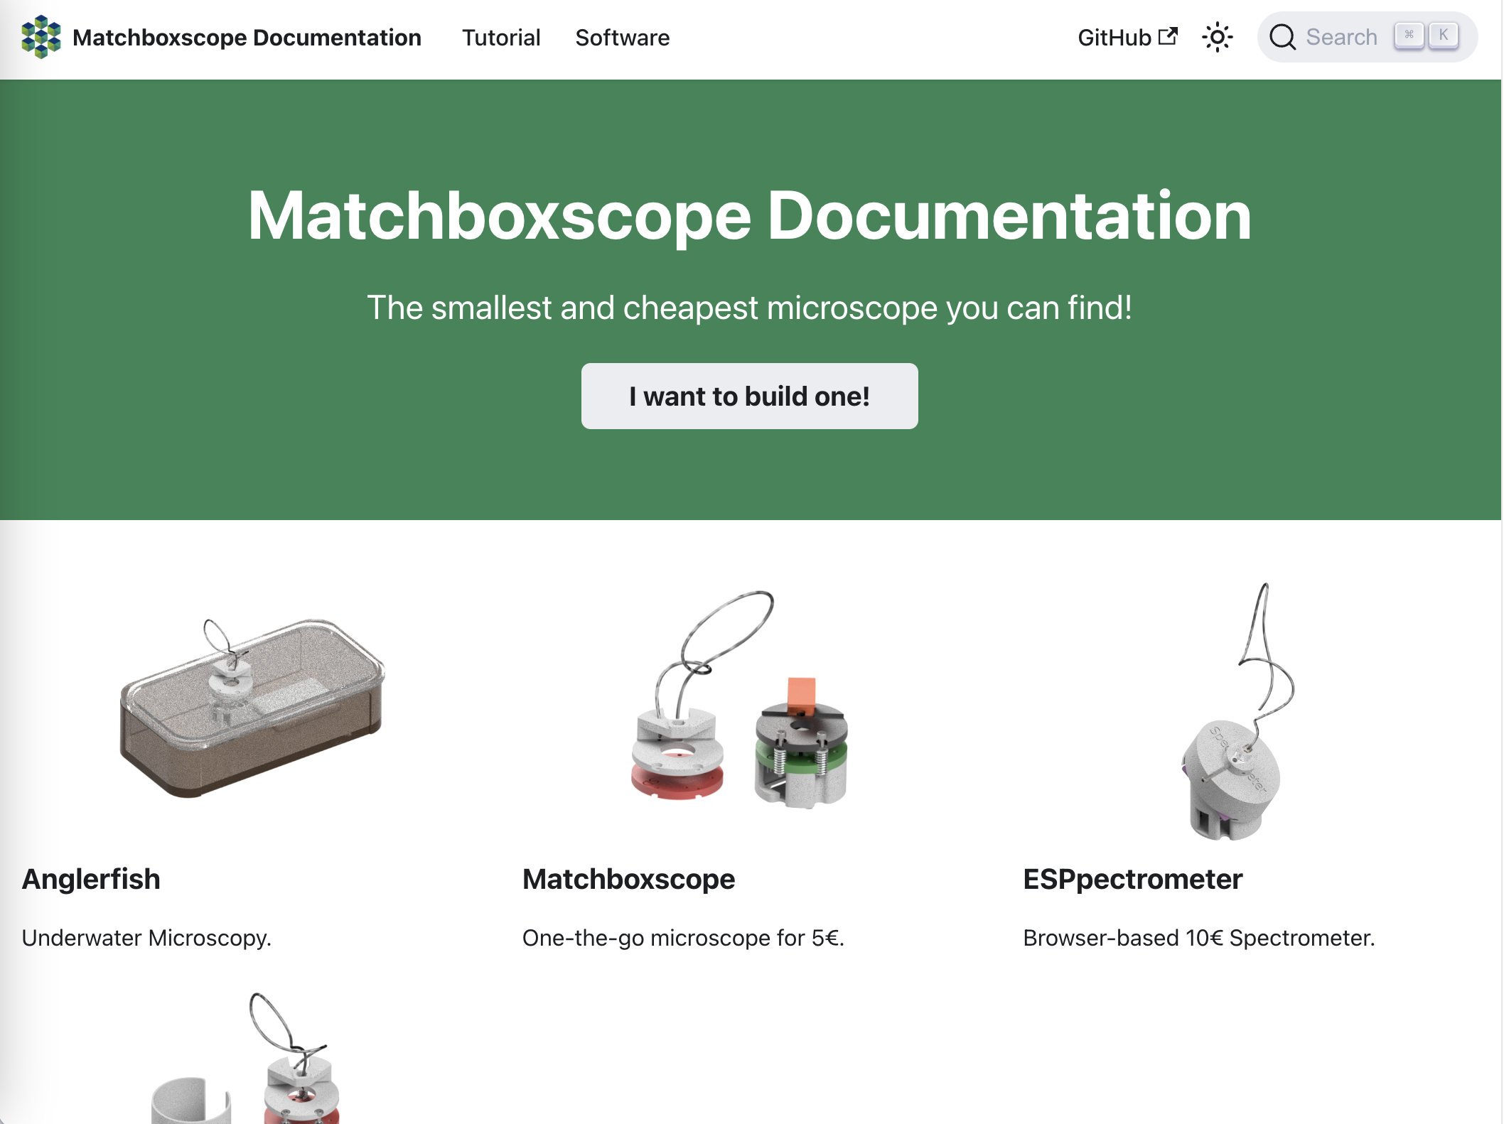
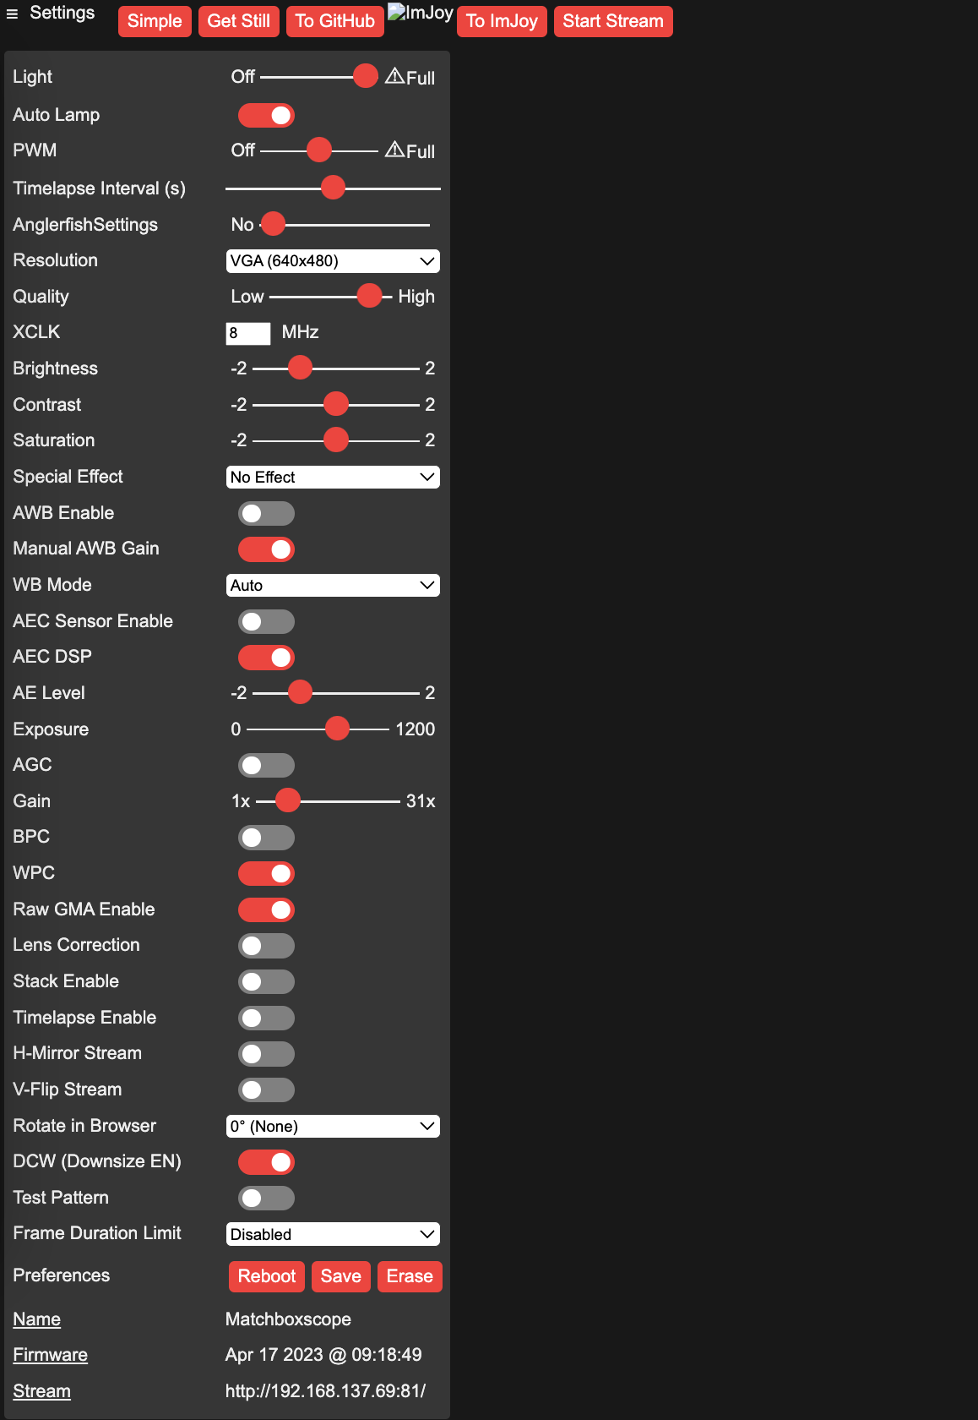
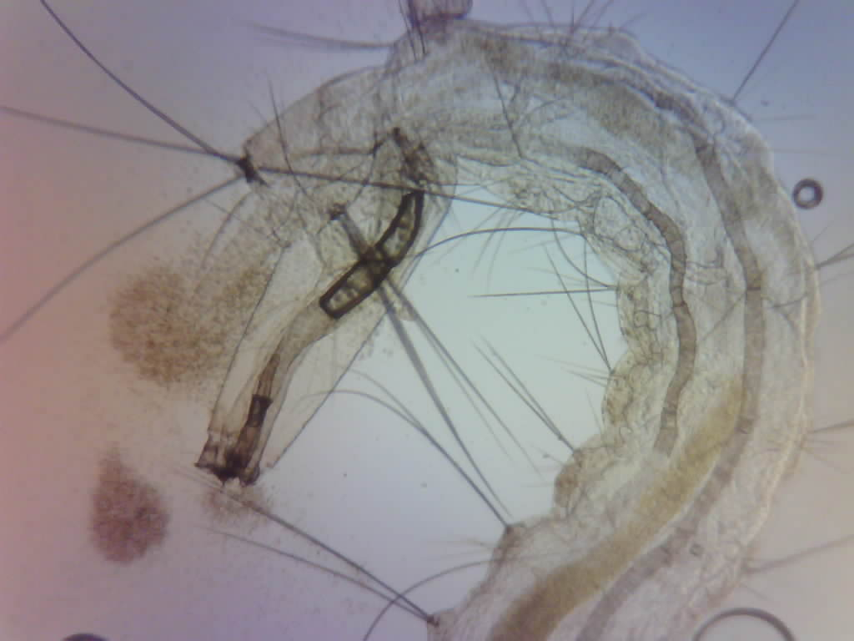
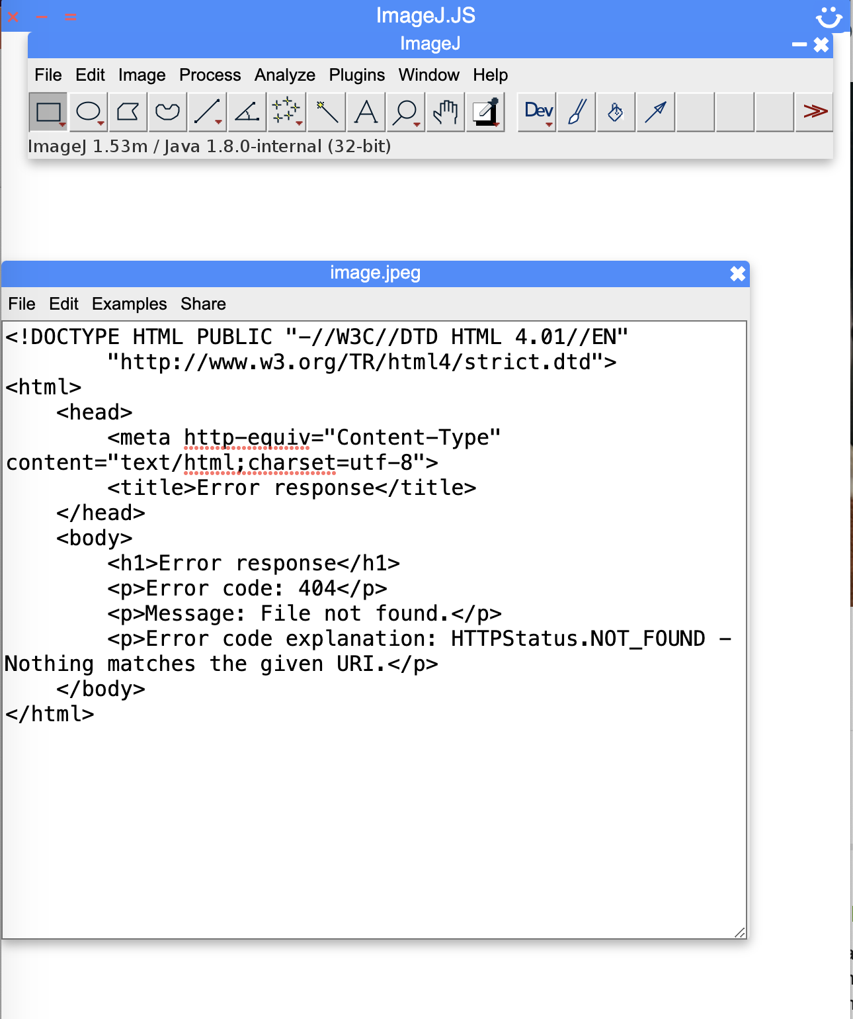

https://matchboxscope.github.io/
Zero-cost
CI-based Infrastructure
Cloud-based infrastructure
Firmware
Flashing Tool
Image Database
+ Gallery
Documentation +
Discussions
Installation-free
upload and configuration
of the firmware
Sharing images in
a publicly available repository
Retrieve latest instructions for hard-/software and gather feedback for improvements
Browser-based Operation
Autonomous Operation
Acquisition UI
Timelapse Imaging
Focus Stacking
Cloud-based image sharing
ESP32-based infrastructure
Image Processing

Slide 9
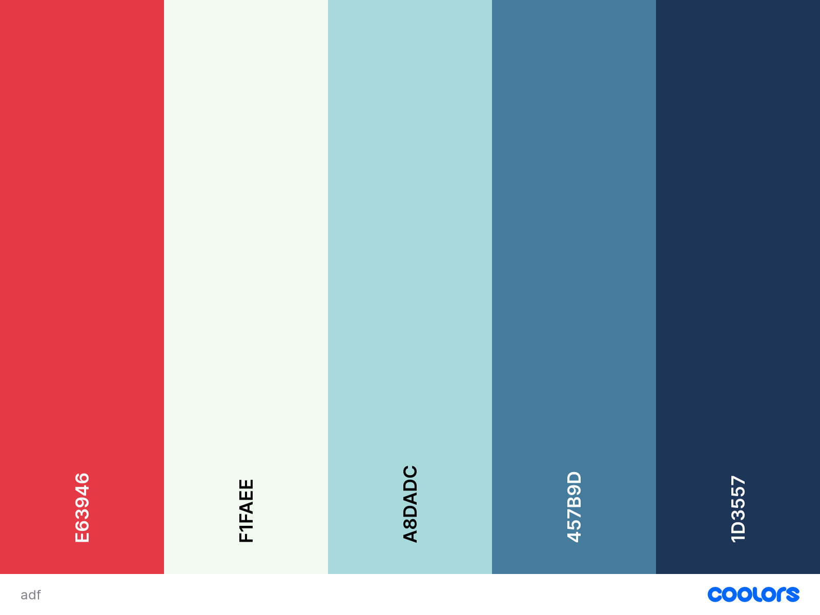
Start
Open AP
User selects WiFi?
Serve at http://192.168.4.1
Serve at http://matchboxscope.local
Capture Still
Render Stream
Focus Stack
Process
Image
Upload Image
Timelapse
Set Camera Parameters
User Selects via Browser

Slide 10
Name | Springloaded Focussing Stage | Magneti-loaded Focussing Stage | VCA Focusing Mechanism | Periscope Illumination | Lightguided Illumination | Ikea USB light | Neopixel Illumination | Waterproof LED lantern | Blue LED with 0.1 Printing Nozzle | Waterproof Container | Peristaltic Pump | Battery | Grating (1000 lines/mm) | 3D printing nozzle (0.25mm) | Comment/ usecase | Compelxity (1=low, 3=high) | Est. Price
Matchbox-Scope | X | (X) |  | x |  |  |  | (x) |  |  |  |  |  |  | field work, only uses ESP32 + 3D printed components | 1 | 10€
Incubator-Scope | X | (X) | x |  |  |  | x | (x) |  |  |  | x |  |  | Focusstacking, Long-termseries on SD card | 2 | 20€
Anglerfish | X |  | X |  | X |  |  | (x) |  | X |  | X |  |  | Autonomous In-Situ Imaging under water | 3 | 30€
Fluidic-Scope | X |  |  |  |  | X |  | (x) |  |  | X |  |  |  | Field work, sampling of waterborn organisms | 3 | 30€
ESPectrometer |  |  |  |  |  | X |  |  |  |  |  |  | X | X | Low-cost spectrometer to visualize wavelengths | 2 | 20€
ESPHolo |  |  |  |  |  |  |  |  | x |  |  |  |  |  | Lensless imaging for inline hologrphy | 1 | 10€

Slide 11
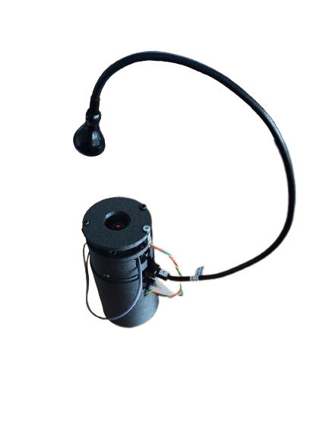
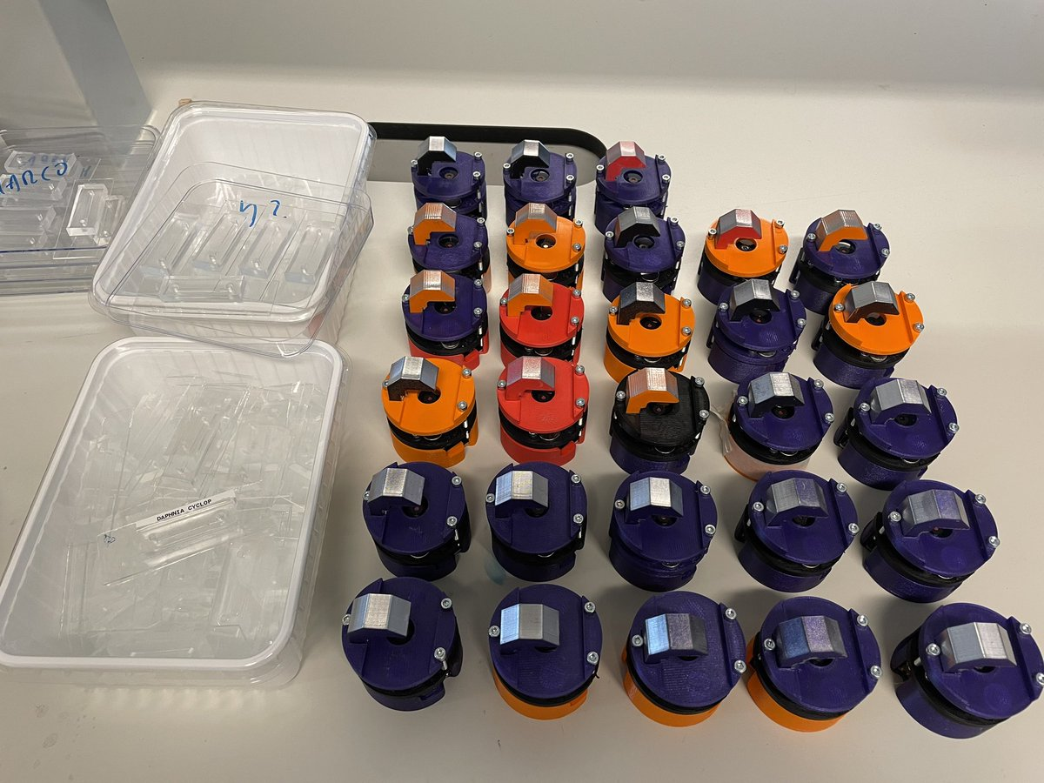
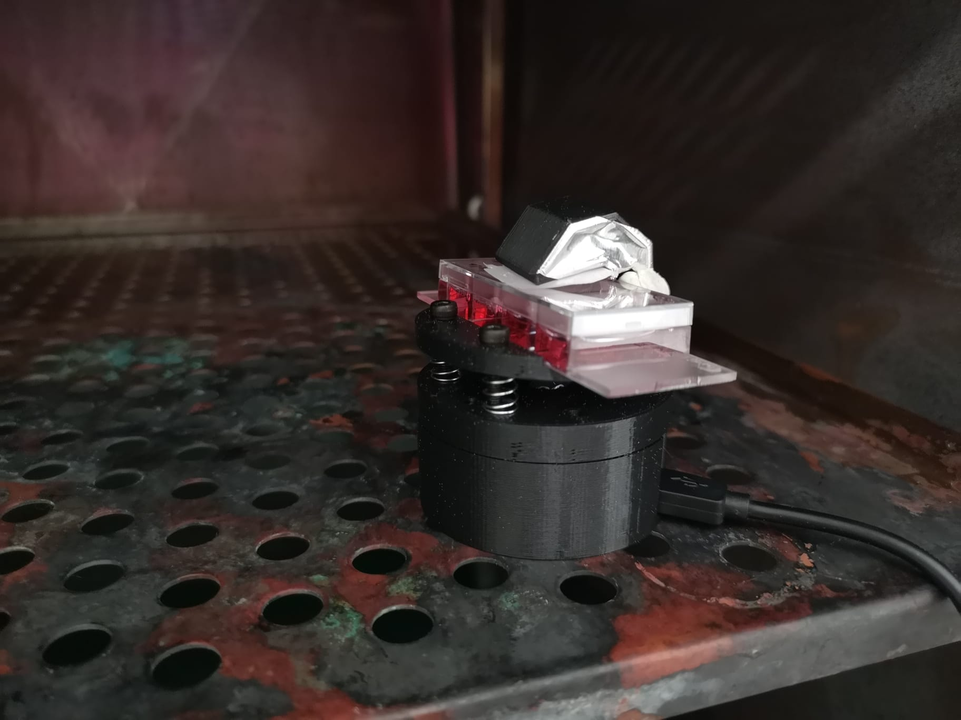
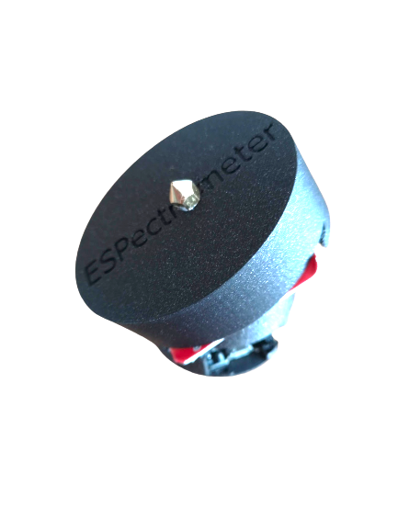
a.)
b.)
Gooseneck lamp (IKEA)
Matchboxscope
Perestaltic Pump
Motor + Controller
c.)
3D printer Nozzle 0.25mm Pinhole
Grating
Matchboxscope

Slide 12





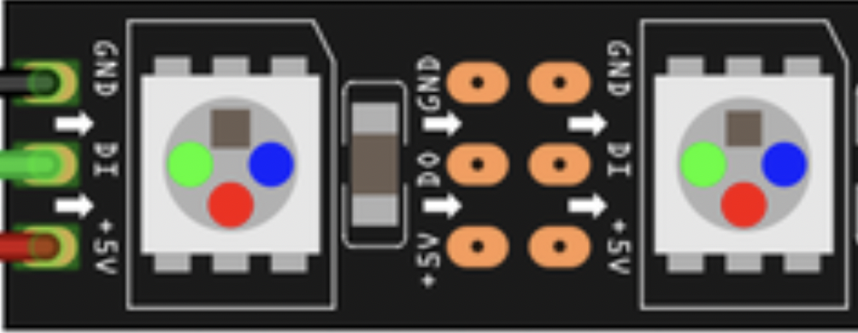
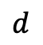
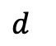
b)
$$d^{}$$
c)
a)
Magnet/Springloaded Stage
Periscope Illumination
$$d^{}$$
d)
j)
Voice-coil Actuator Focusing
Addons
Lightguided Illumination
e)
Battery
Ikea USB light
Peristaltic Pump
h)
f)
i)
Diffraction
grating
Battery-driven lamp
Neopixel Illumination
Waterproof
Container
g)

Slide 13
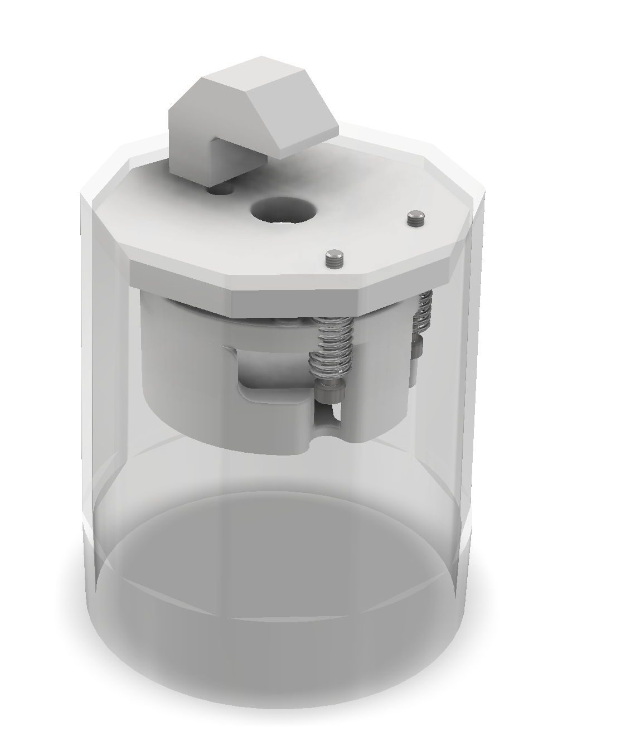
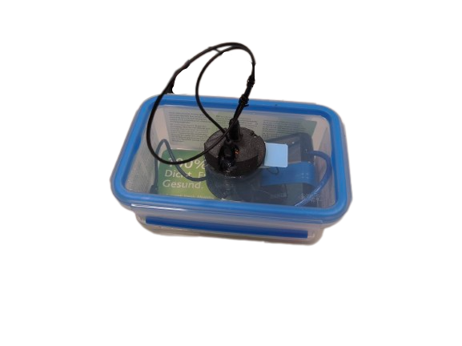
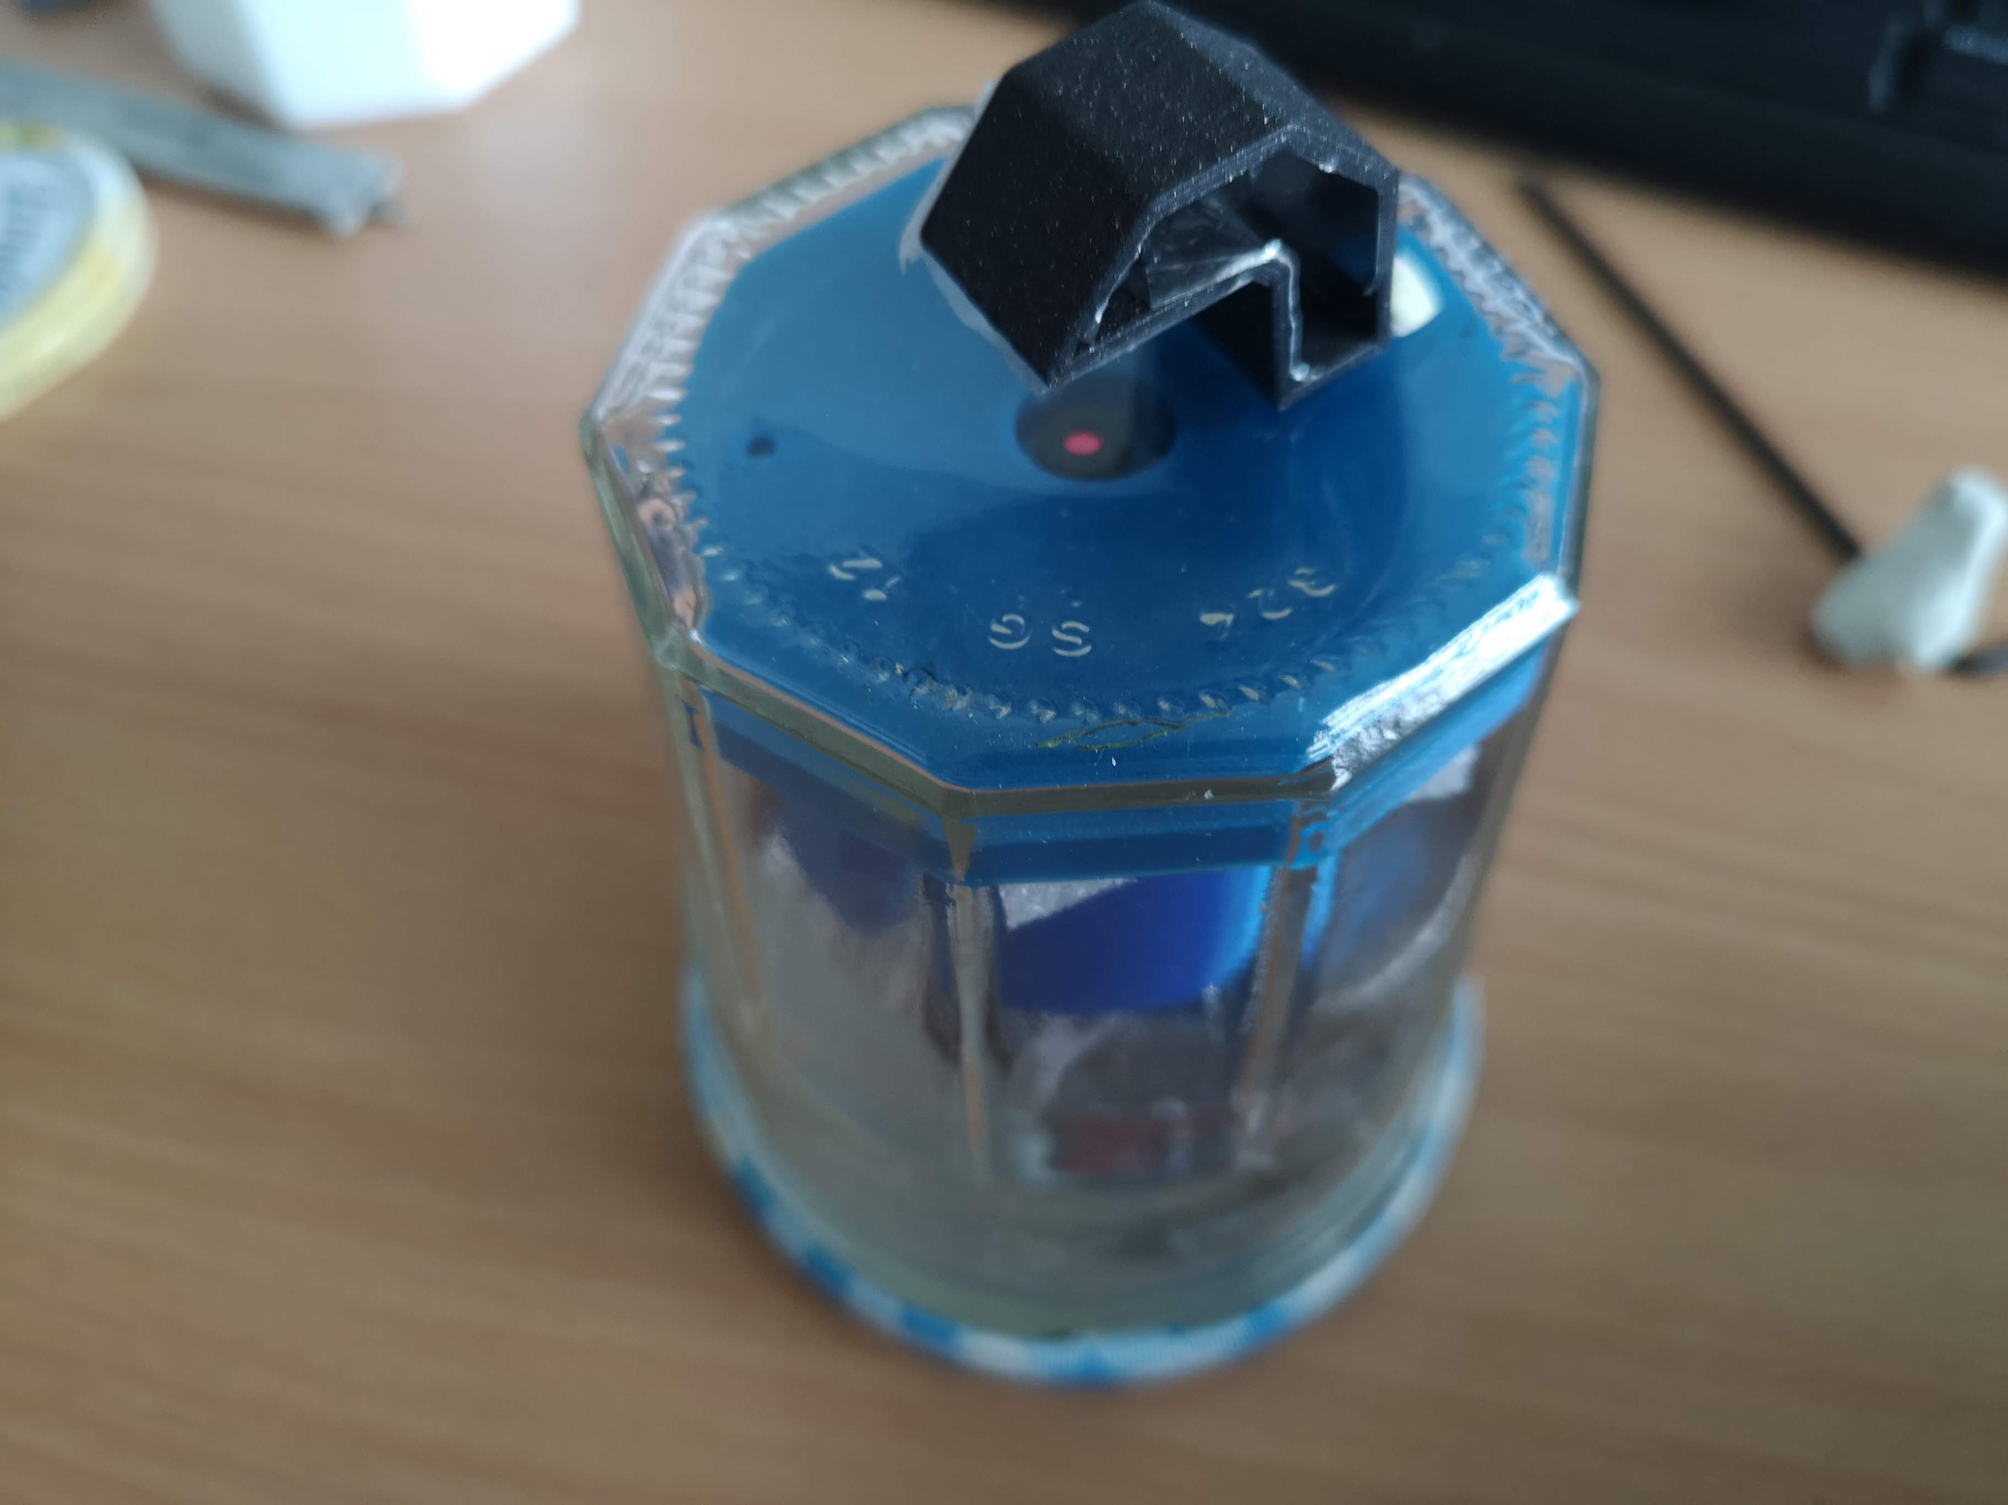
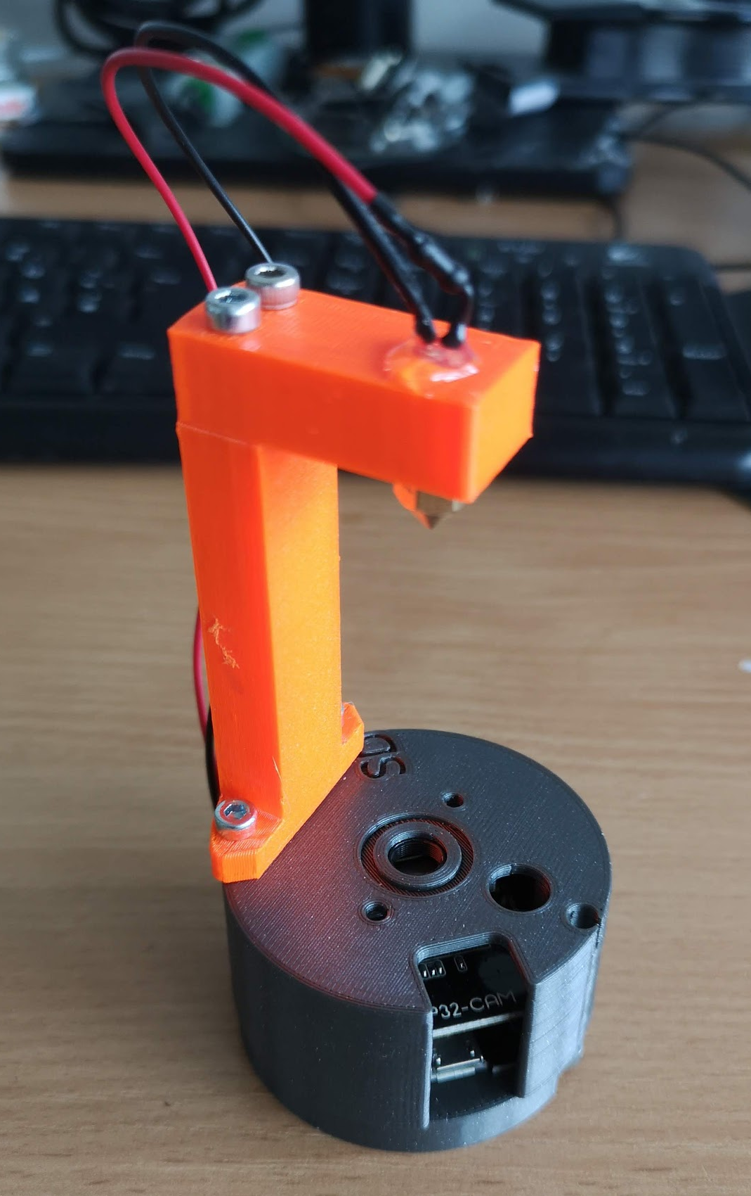
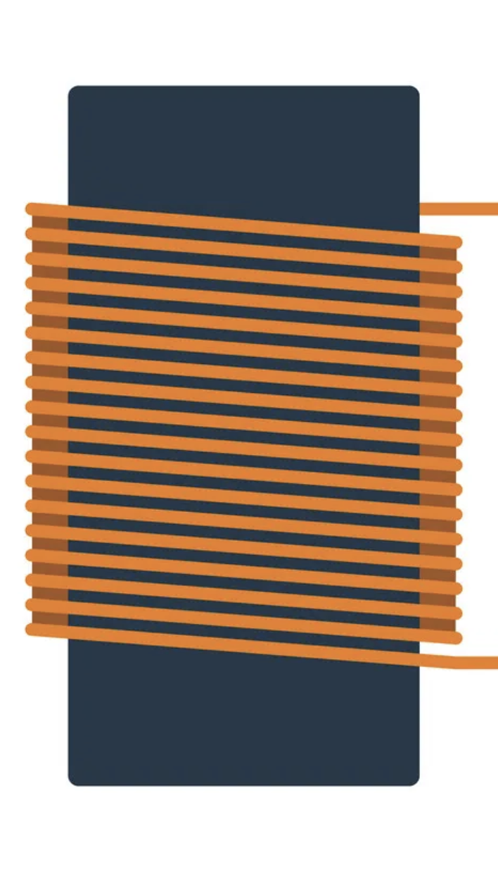
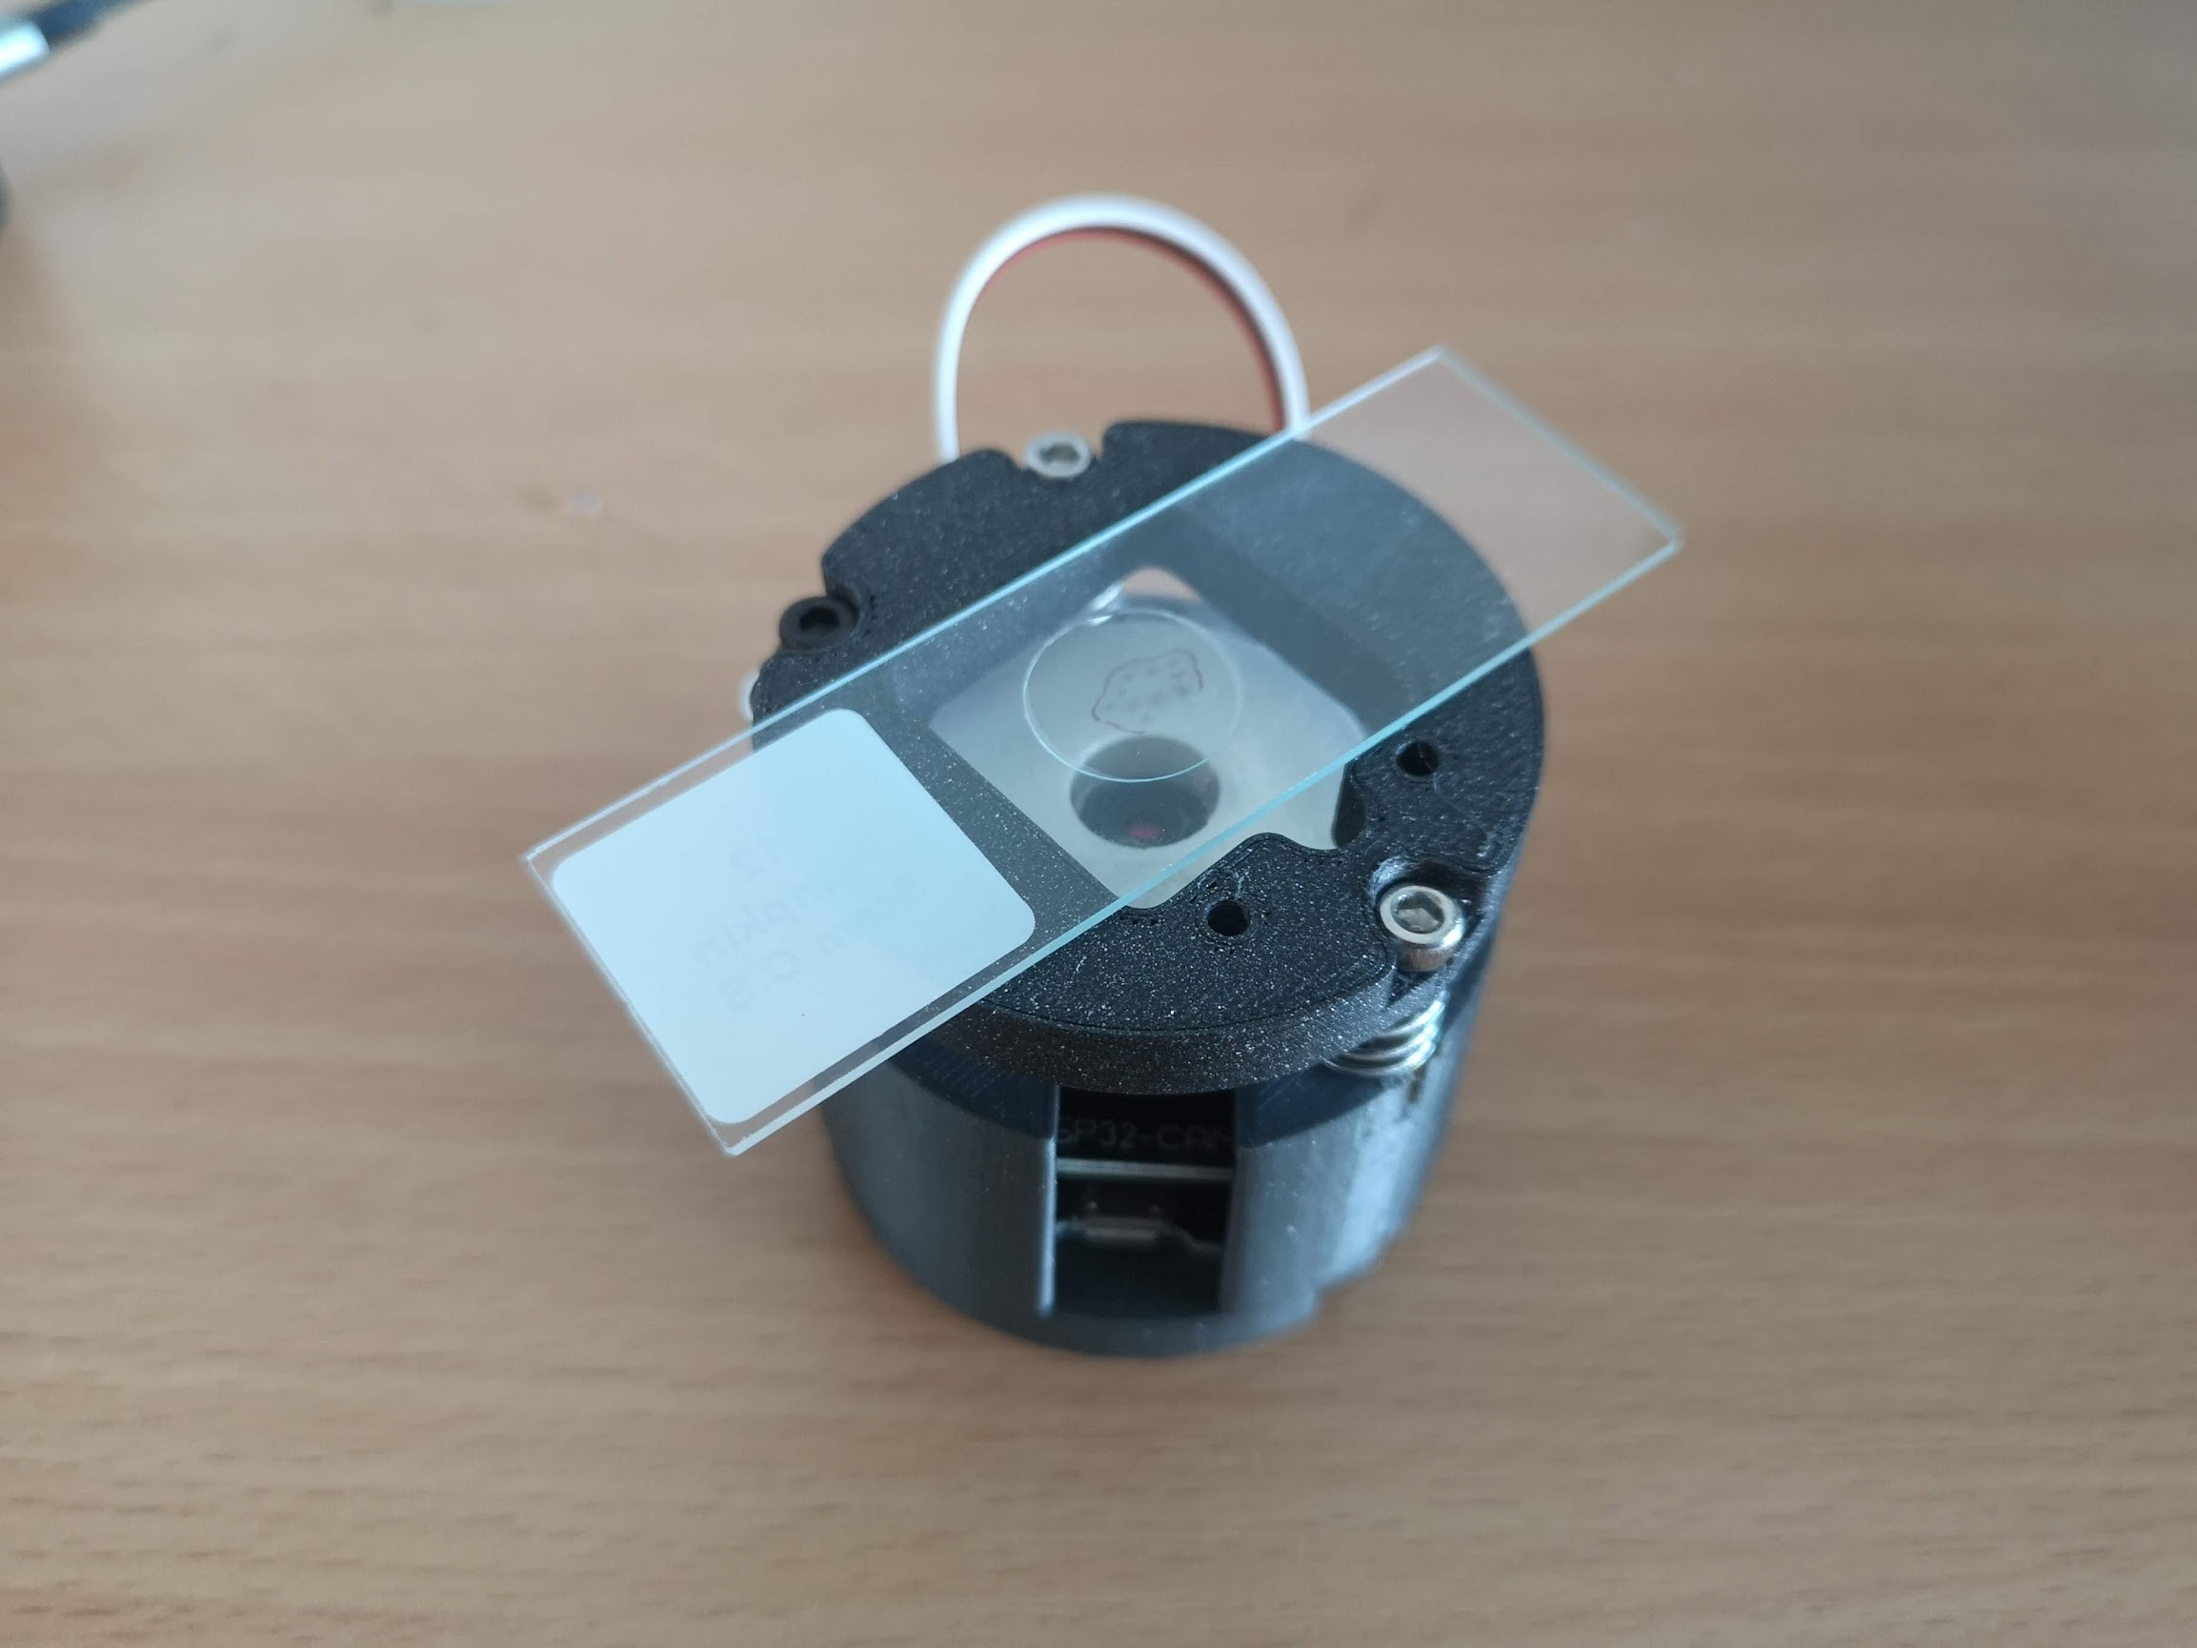
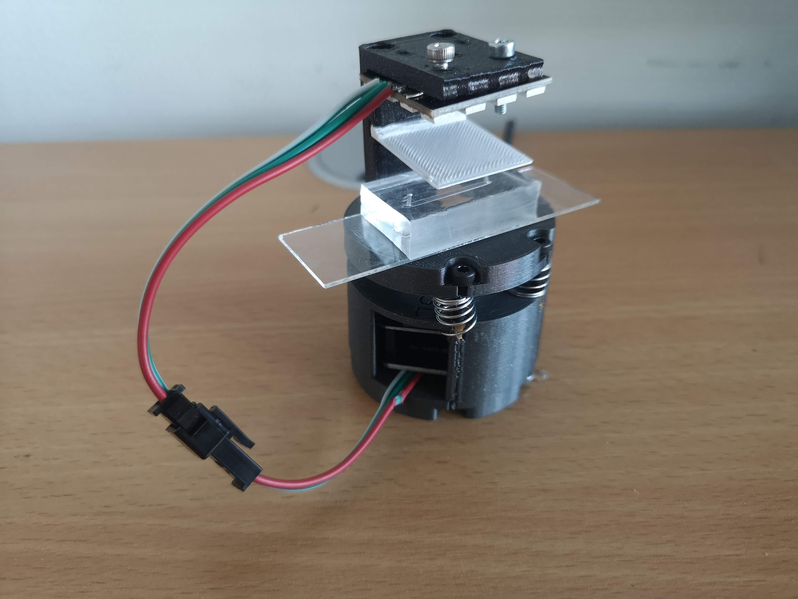
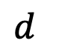
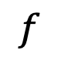
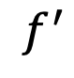
Toslink
a)
b)
c)
d)
Watertight Lunchbox
Mirror / Silver Spray
e)
LED
Printing
Nozzle
Jar Bottom / Glass Slide
$$f^{}$$
Objective Lens
$$d^{}$$
Voice Coil Actuator (optional)
$$f^{′}$$
Camera Sensor
ESP32
CAM
Torch LED (flash)
ESP32 PCB
f)
g)
Neopixel
Ring/Matrix

Slide 14
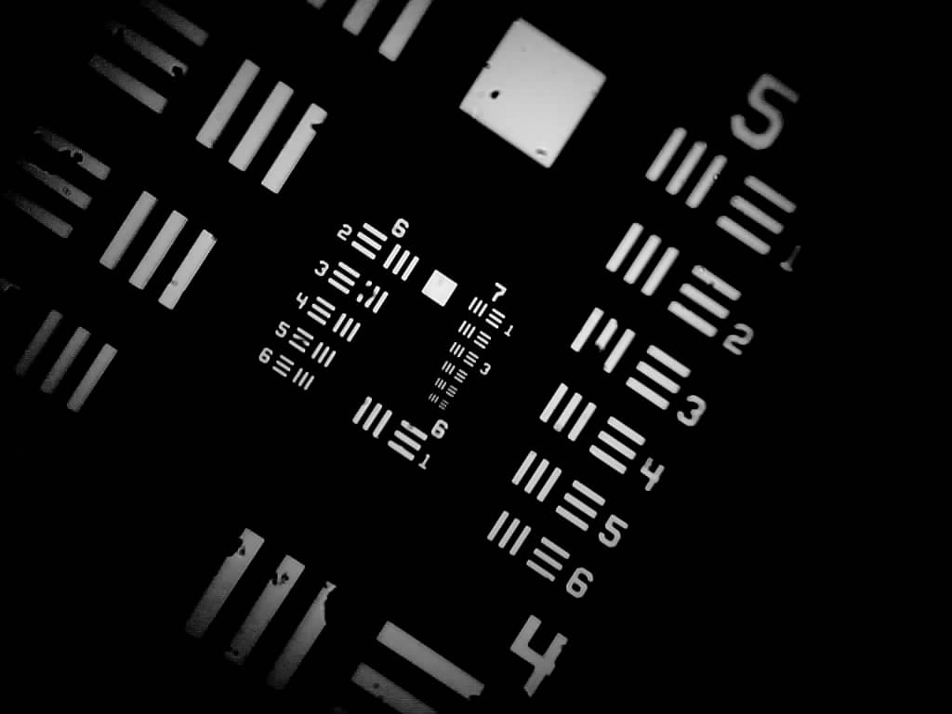
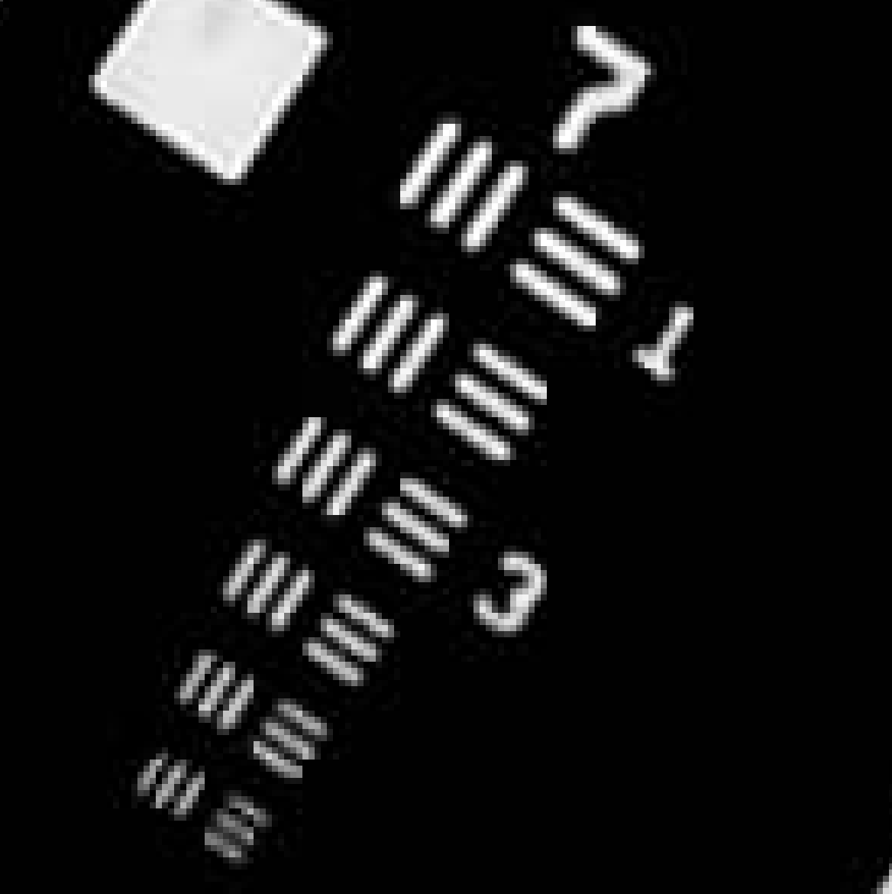
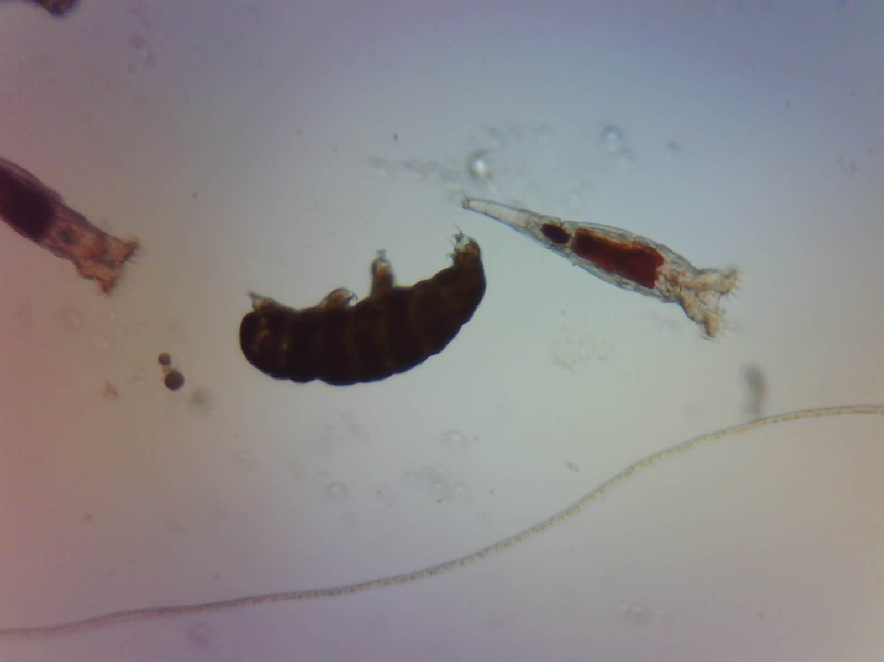
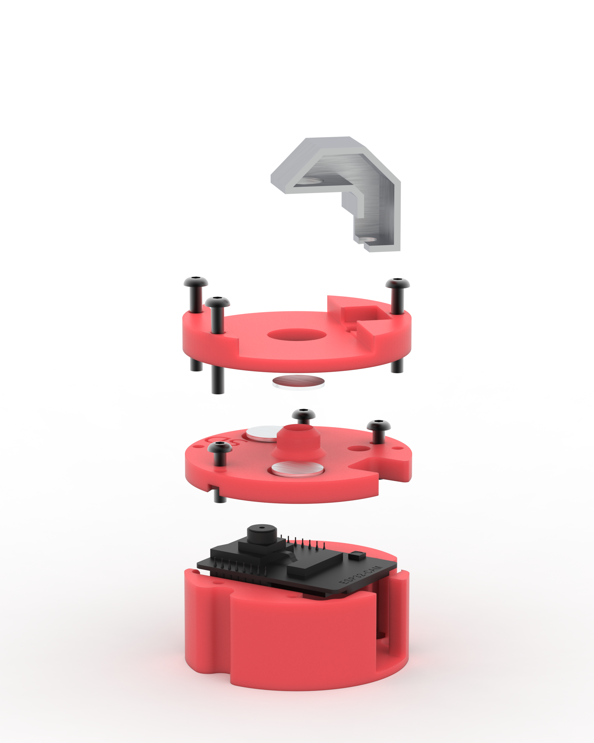
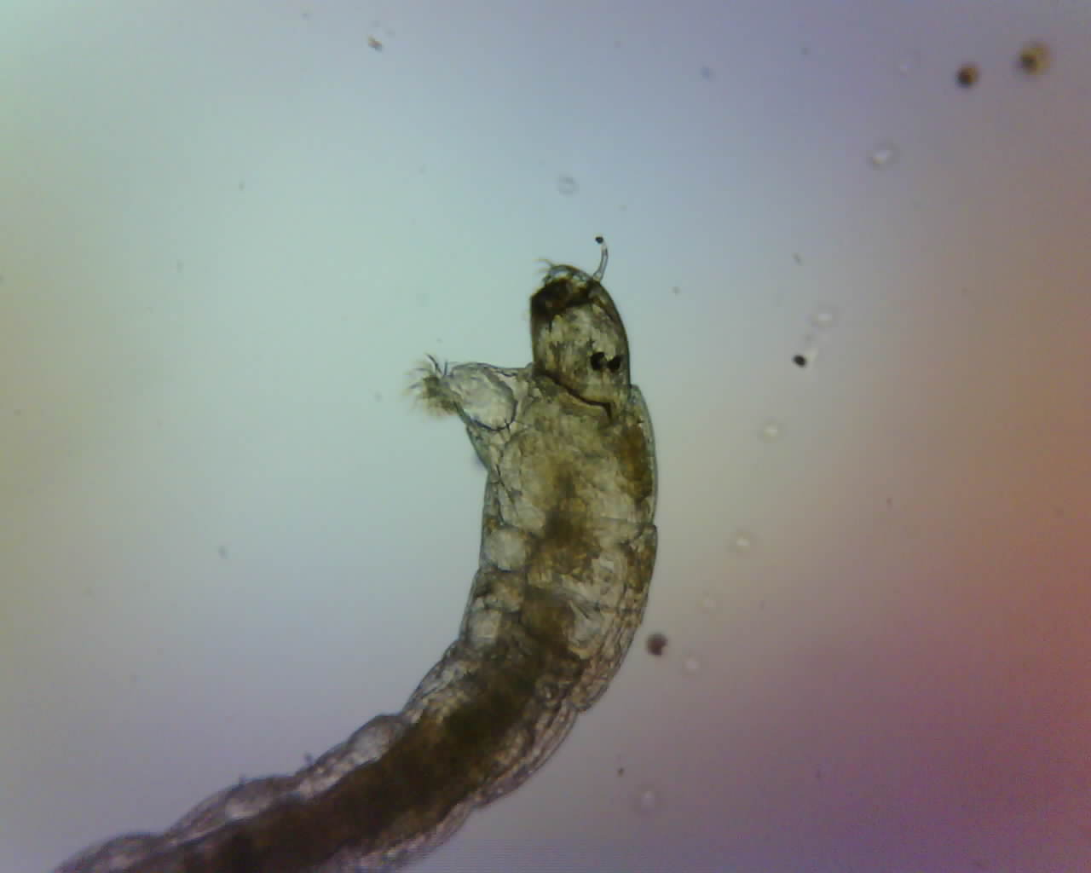
a)
b)
c)
d)
e)
h)
Illumination Periscope
Sample Stage
f)
g)
Lid and Optics Holder
Camera (unfolded)
ESP32 Camera
ESP32 Camera MB
Base

Slide 15
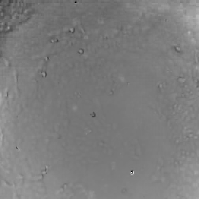
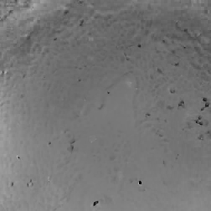
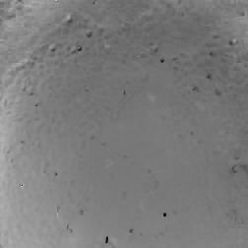
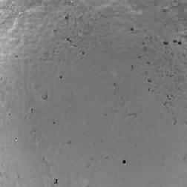
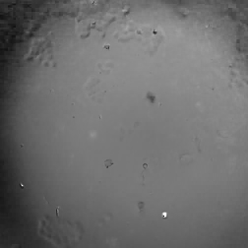
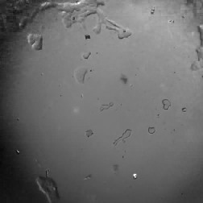
200µm
t=0min
t=6h
t=13h
t=25h
t=44h
t=60h

